Slide 1
OPTIMIZING DELIVERY ROUTES FOR COST EFFECTIVE AND EFFICIENT PACKAGE DELIVERY
DESIGN AND ANALYSIS OF ALGORITHMS – CBS 3003
Presented By:
Anvesha Churi
Pratyush Dubey

Slide 2
Problem Statement
- Need to optimize delivery routes for a logistics company with multiple warehouses and gas stations
- Key Constraints:
Limited vehicle fuel capacity (250 units)
Limited cargo capacity (user-defined)
Multiple warehouses and gas stations at fixed locations
Multiple delivery destinations with varying package weights
Need to minimize:
- Total distance travelled
- Number of refuelling stops

Slide 3

Real-World Applications
E-commerce delivery optimization
Supply chain logistics
Food delivery services
Courier services
Waste collection routes
Emergency service routing

Slide 4
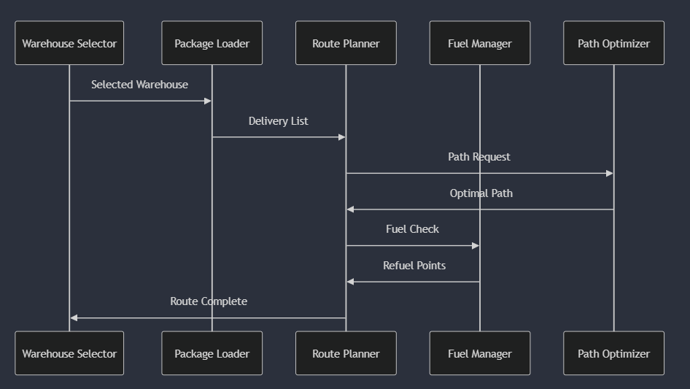
System Components
Warehouse Selection
Package Loading Optimization
Route Planning
Fuel Management
Path Optimization

Slide 5
Algorithms Discussion

Slide 6
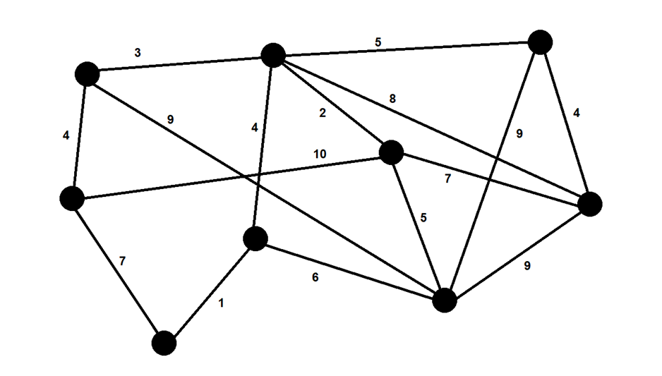
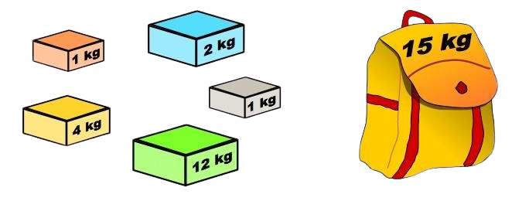
Key Algorithms & Techniques Used
Floyd-Warshall Algorithm
Greedy Knapsack Algorithm
Dijkstra's Algorithm

Slide 7
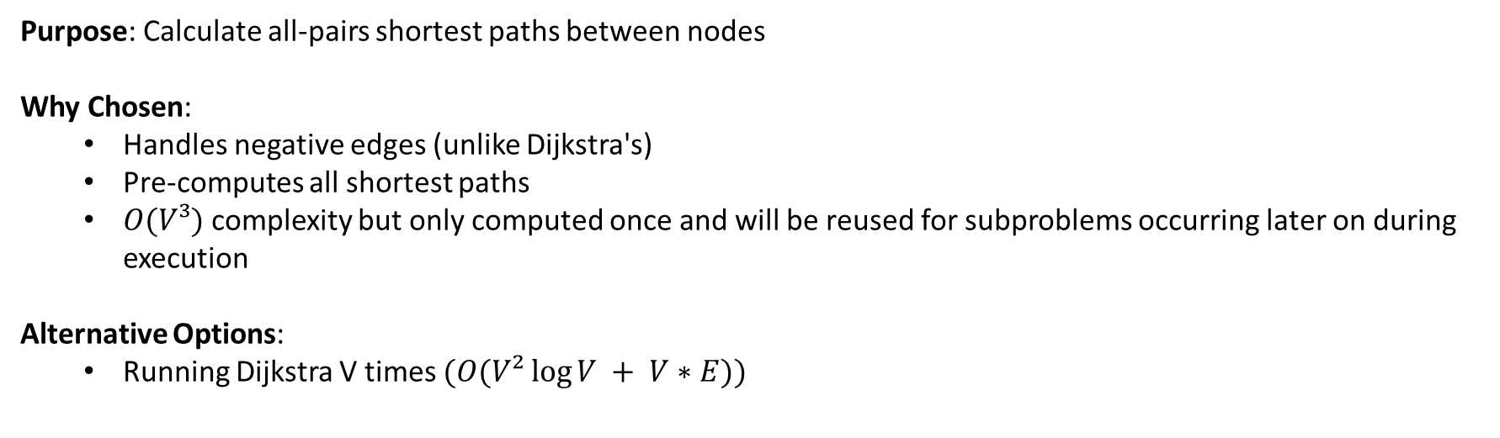
Floyd-Warshall Algorithm
Purpose: Calculate all-pairs shortest paths between nodes Why Chosen:
Handles negative edges (unlike Dijkstra's)
Pre-computes all shortest paths
$O(V³)$ complexity but only computed once and will be reused for subproblems occurring later on during execution
Alternative Options:
Running Dijkstra V times $(O(V² log⁡V + V∗E))$

Slide 8
Floyd-Warshall Algorithm
Pseudocode: function floydWarshall(graph):
for k = 1 to V:
for i = 1 to V:
for j = 1 to V:
dist[i][j] = min(dist[i][j], dist[i][k] + dist[k][j])
The algorithm iteratively updates the shortest paths between all pairs of nodes by checking if a path through an intermediate node offers a shorter path than the previously known direct path.

Slide 9
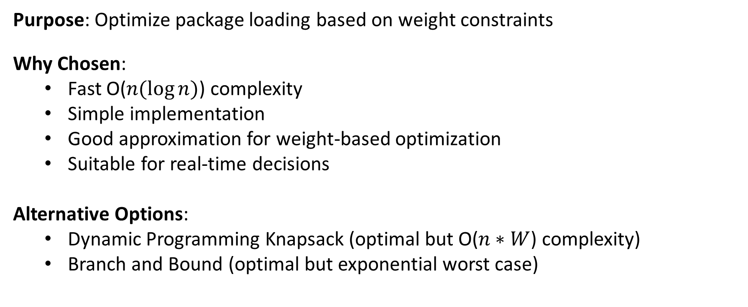
Greedy Knapsack Algorithm
Purpose: Optimize package loading based on weight constraints Why Chosen:
Fast O($n(\log{n})$) complexity
Simple implementation
Good approximation for weight-based optimization
Suitable for real-time decisions
Alternative Options:
Dynamic Programming Knapsack (optimal but O($n∗W$) complexity)
Branch and Bound (optimal but exponential worst case)

Slide 10
Greedy Knapsack Algorithm
Pseudocode: function greedyKnapsack(items, capacity):
// Sort items by value-to-weight ratio in descending order
sort items by (item.value / item.weight) in descending order
result = empty list
for each item in items:
if item.weight <= capacity:
add item to result
capacity -= item.weight
return result

Slide 11
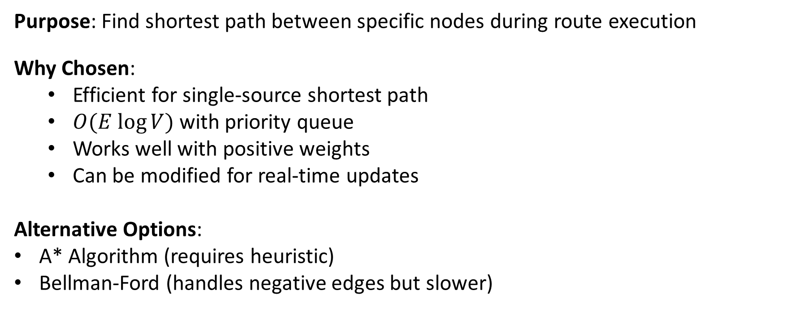
Dijkstra's Algorithm
Purpose: Find shortest path between specific nodes during route execution Why Chosen:
Efficient for single-source shortest path
$O(E log⁡V)$ with priority queue
Works well with positive weights
Can be modified for real-time updates
Alternative Options:
A* Algorithm (requires heuristic)
Bellman-Ford (handles negative edges but slower)

Slide 12
Dijkstra’s Algorithm
Pseudocode: function dijkstra(graph, source, target):
initialize distances[] to infinity
distances[source] = 0
priority_queue pq // min heap implementation at backend
pq.push((0, source))
while pq not empty:
current = pq.pop()
for each neighbor of current:
if new_distance < distances[neighbor]:
distances[neighbor] = new_distance
pq.push((new_distance, neighbor))

Slide 13
System Components

Slide 14
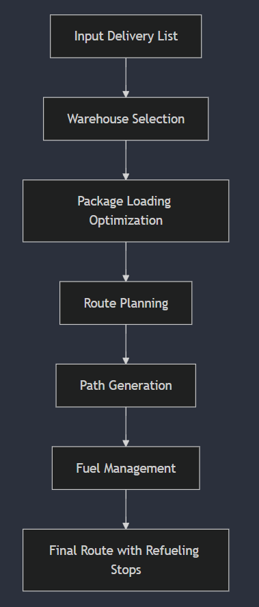
System Components
Warehouse Selection
Package Loading Optimization
Route Planning
Fuel Management
Path Optimization

Slide 15
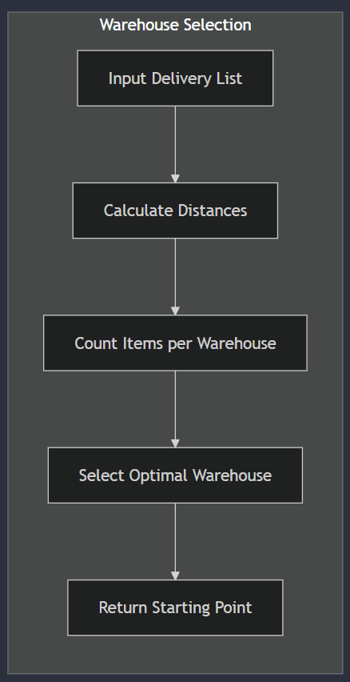
Warehouse Selection
Purpose:
Determine the most efficient starting warehouse for a set of deliveries
Balance load across multiple warehouses
Minimize initial travel distance

Slide 16
Warehouse Selection
int wareHouseSelection(vectorpair<int, int>> List) {
vector<pair<int, int>> data;
// Calculate distances to warehouses
for (auto& item : List) {
int mini = INT_MAX;
int selectedWarehouse = -1;
for (int wareHouse : wareHouses) {
if (dist[wareHouse][item.first] < mini) {
mini = dist[wareHouse][item.first];
selectedWarehouse = wareHouse;
}
}
data.push_back({selectedWarehouse, mini});
}
// Count and select optimal warehouse
vector<int> counters(V, 0);
for (auto& item : data) {
counters[item.first]++;
}
int maxCount = 0, resultWarehouse = -1;
for (int wareHouse : wareHouses) {
if (counters[wareHouse] > maxCount) {
maxCount = counters[wareHouse];
resultWarehouse = wareHouse;
}
}
return resultWarehouse;
}

Slide 17
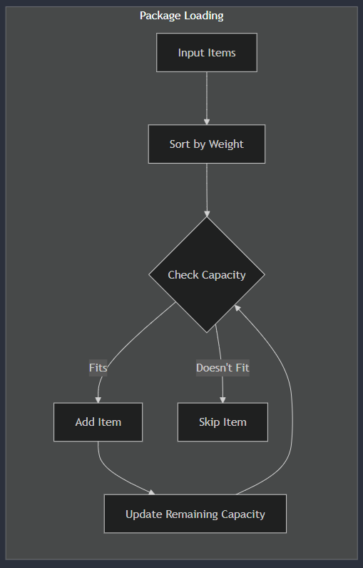
Package Loading Optimization
Purpose:
Optimize vehicle loading based on capacity constraints
Ensure maximum utilization of available capacity
Prioritize items based on weight efficiency

Slide 18
Package Loading Optimization
Code:
vector<pair<int, int>> SystematicPackaging(
vector<pair<int, int>> List,
int capacity) {
vector<pair<int, int>> finalListOfItems;
sort(List.begin(), List.end(), comp);
int i = 0;
while (i < List.size() && List[i].second <= capacity) {
capacity -= List[i].second;
finalListOfItems.push_back(List[i]);
i++;
}
return finalListOfItems;
}

Slide 19
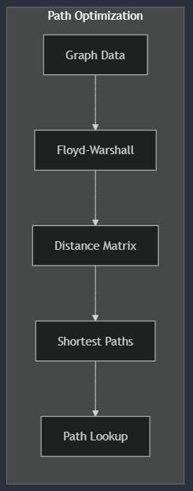
Path Optimization
Purpose:
Pre-compute optimal paths
Maintain distance matrix
Provide quick path lookups

Slide 20
Path Optimization
Code:
void floydwarshall() {
// Initialize distance matrix
for (int i = 0; i < V; i++) {
for (auto adjNode : adj[i]) {
dist[i][adjNode.first] = adjNode.second;
}
dist[i][i] = 0;
}
// Calculate all-pairs shortest paths
for (int k = 0; k < V; k++) {
for (int i = 0; i < V; i++) {
for (int j = 0; j < V; j++) {
if (dist[i][k] < 1e7 && dist[k][j] < 1e7) {
dist[i][j] = min(dist[i][j],
dist[i][k] + dist[k][j]);
}
}
}
}
}

Slide 21
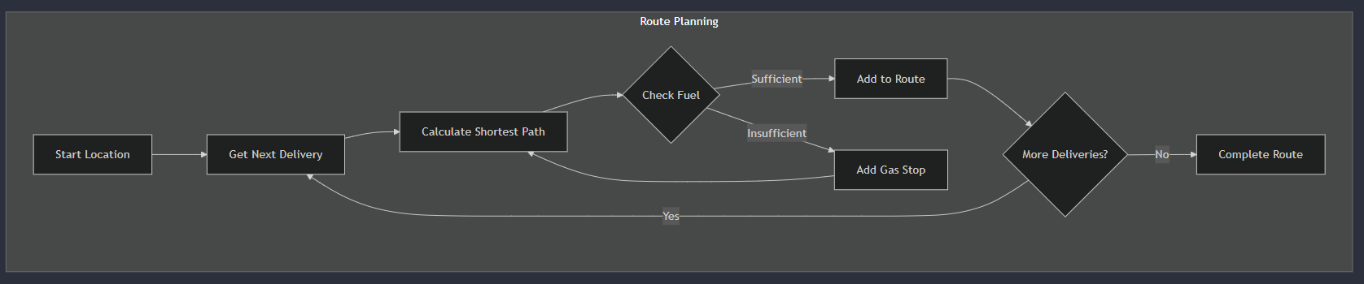
Route Planning
Purpose:
Generate optimal delivery sequence
Handle path finding between points
Manage route constraints

Slide 22
Route Planning
Code:
// Dijkstra's algorithm implementation
while (!pq.empty()) {
int dis = pq.top().first;
int node = pq.top().second;
pq.pop();
if (dis > dist[node]) continue;
for (auto& adjNode : adj[node]) {
int newDist = dis + adjNode.second;
if (newDist < dist[adjNode.first]) {
dist[adjNode.first] = newDist;
pq.push({newDist,adjNode.first});
parent[adjNode.first] = node;
}
}
}
return reconstructPath(parent, srcNode, lastNode);
}
vector<int> shortestPath(int srcNode, int lastNode) {
priority_queue<pair<int, int>,
vector<pair<int, int>>,
greater<pair<int, int>>> pq;
vector<int> dist(V, INT_MAX), parent(V);
// Initialize path finding
for (int i = 0; i < V; i++) parent[i] = i;
dist[srcNode] = 0;
pq.push({0, srcNode});

Slide 23
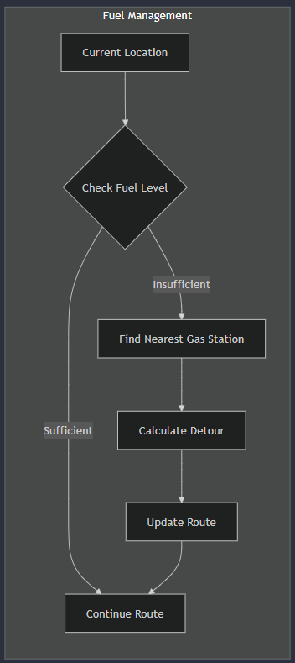
Fuel Management
Purpose:
Monitor vehicle fuel levels
Plan refueling stops
Optimize fuel consumption

Slide 24
Fuel Management
Code:
int NumberOfRefill(vector<pair<int, int>> FinalList) {
int refillCount = 0, fuelLeft = Tankcap;
int srcNode = wareHouseSelection(FinalList);
// Calculate refills needed for route
for (auto& item : FinalList) {
vector<int> path = shortestPath(srcNode, item.first);
for (size_t j = 0; j < path.size() - 1; j++) {
int travelDist = dist[path[j]][path[j + 1]];
if (fuelLeft < travelDist) {
fuelLeft = Tankcap;
refillCount++;
}
fuelLeft -= travelDist;
}
srcNode = item.first;
}
return refillCount;
}
int NearGasStation(int srcNode) {
int minDist = INT_MAX, nearestStation = -1;
// Find closest gas station
for (int station : GasStation) {
if (dist[srcNode][station] < minDist) {
minDist = dist[srcNode][station];
nearestStation = station;
}
}
return nearestStation;
}

Slide 25
Components Interaction

Slide 26
System Architecture

Slide 27
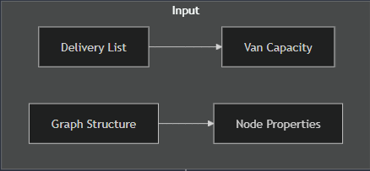
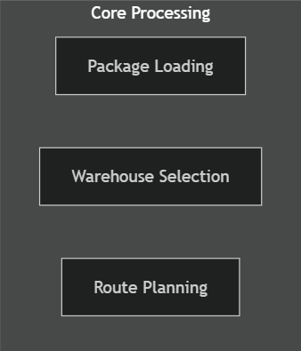
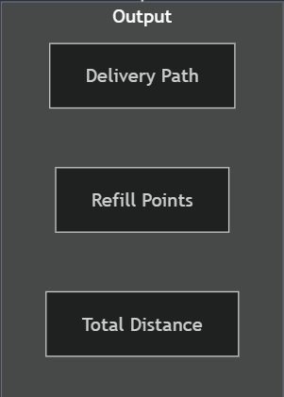
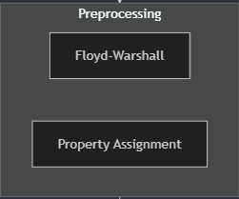
System Architecture

Slide 28
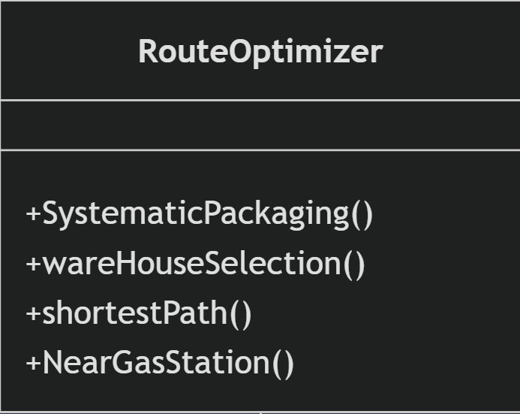
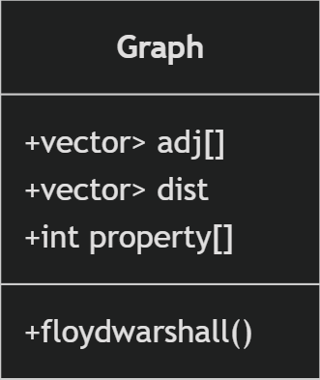
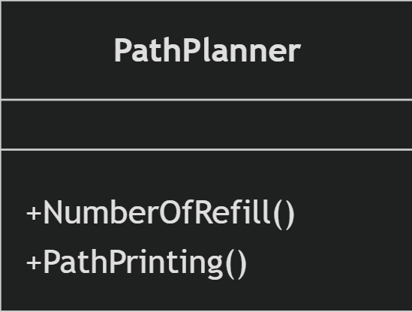
Code Structure and Dependencies

Slide 29
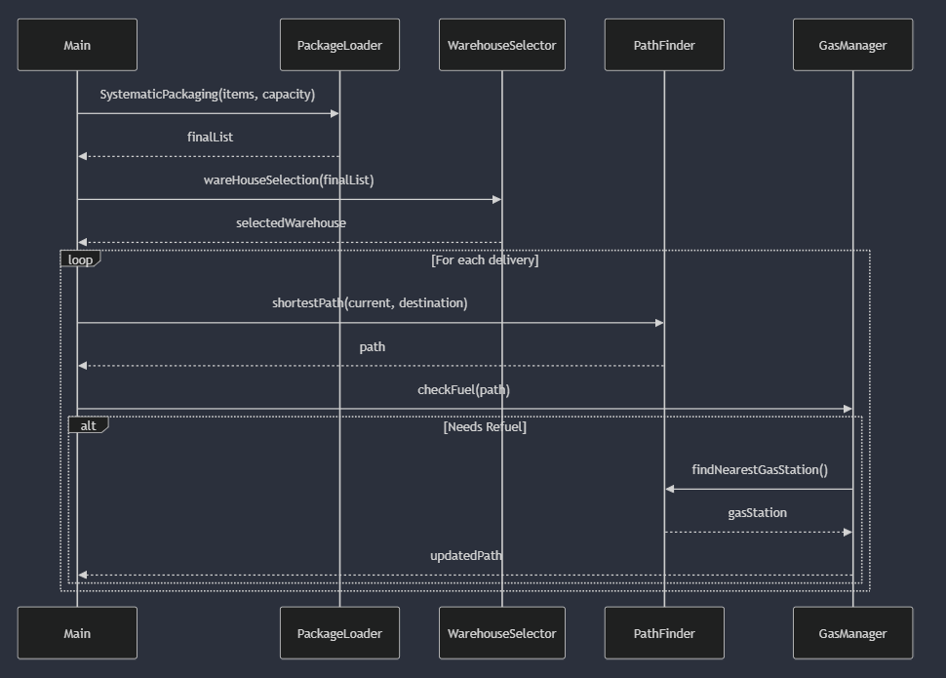
Code Flow: Detailed Example

Slide 30
Performance and Testing

Slide 31
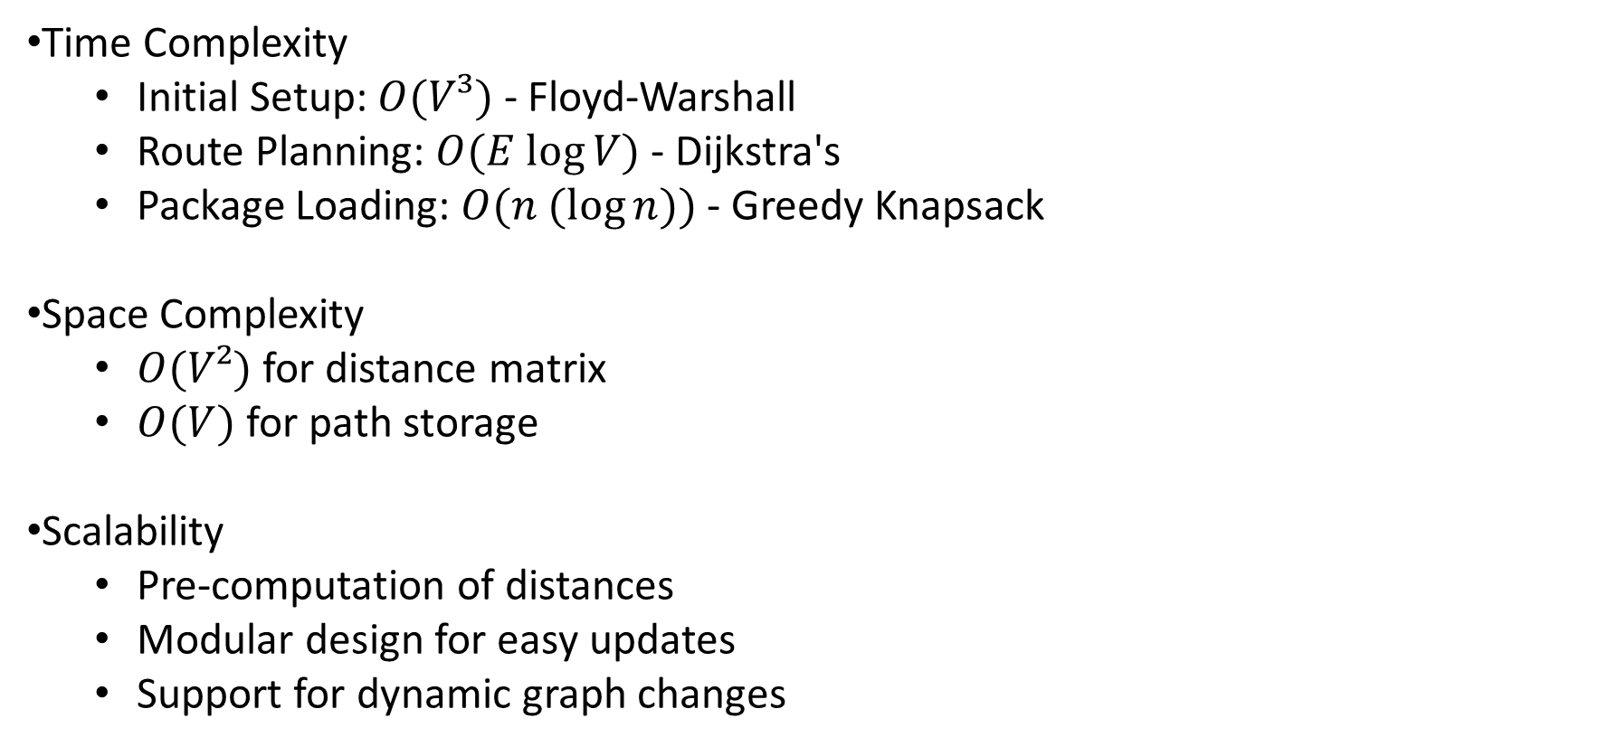
Performance Considerations
Time Complexity
Initial Setup: $O(V³)$ - Floyd-Warshall
Route Planning: $O(E log⁡V)$- Dijkstra's
Package Loading: $O(n (\log{n}))$- Greedy Knapsack
Space Complexity
$O(V²)$ for distance matrix
$O(V)$ for path storage
Scalability
Pre-computation of distances
Modular design for easy updates
Support for dynamic graph changes

Slide 32
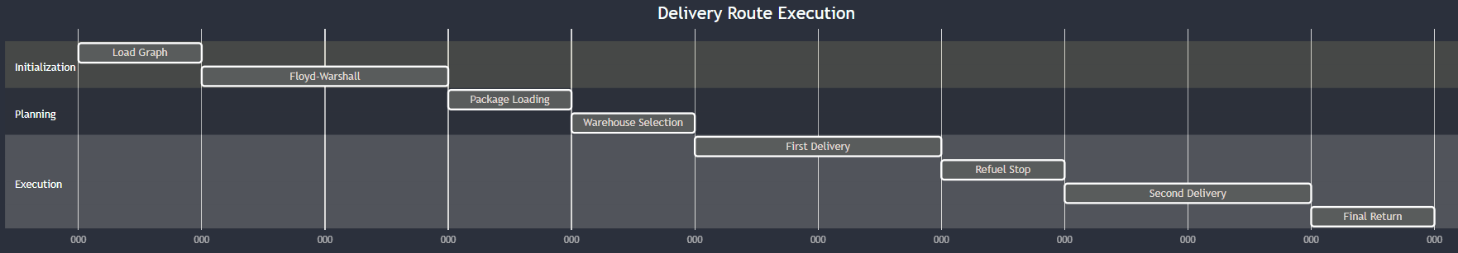
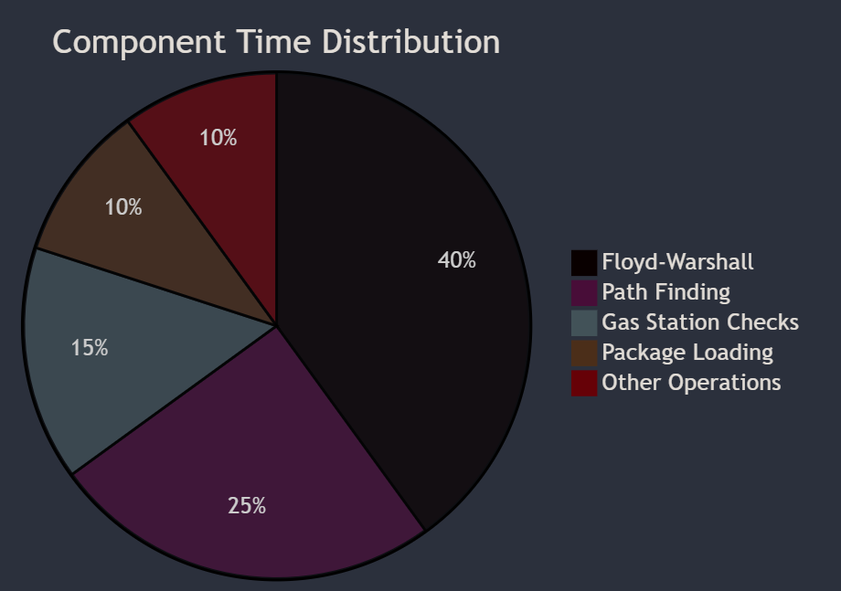
Example Execution Trace
Performance Analysis Dashboard

Slide 33
Testing and Edge Cases
Graph Scenarios
Disconnected components
Single warehouse
Limited gas stations
Dead ends
Capacity Constraints
Full capacity
Empty tank
Minimal remaining capacity
Maximum load
Route Challenges
No feasible path
Multiple equal-length paths
Forced refueling points
Circular routes

Slide 34
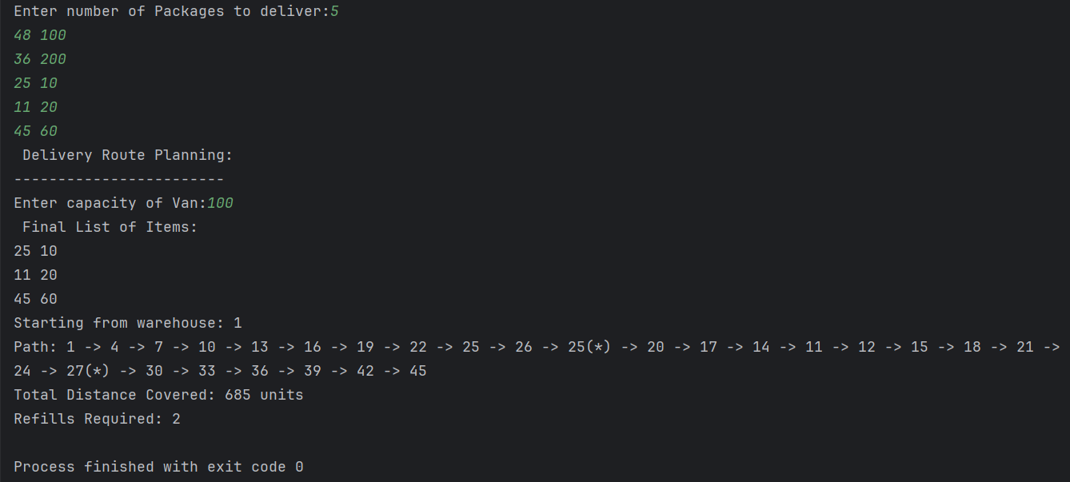
Solving Toy Examples
Case 1: General case

Slide 35
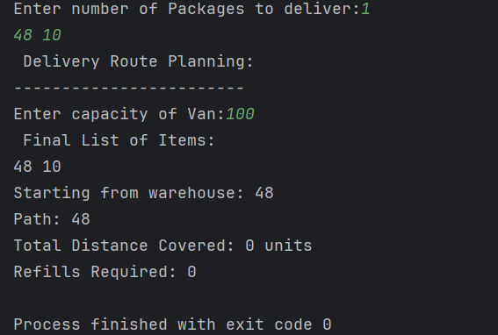
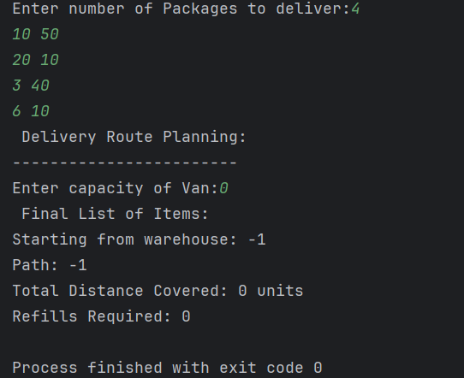
Case 2: Items to deliver at warehouse
Case 3: Van weight capacity = 0

Slide 36
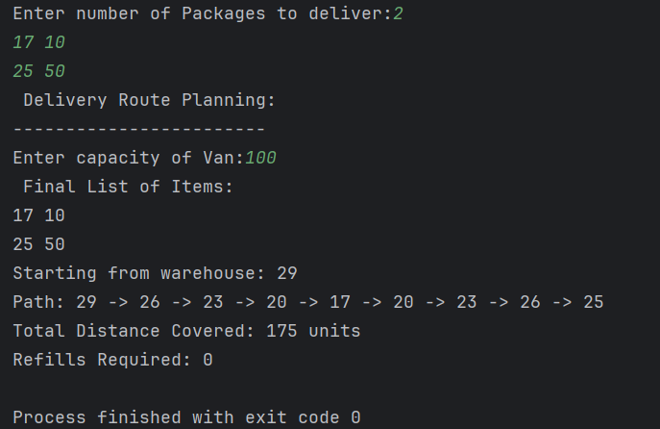
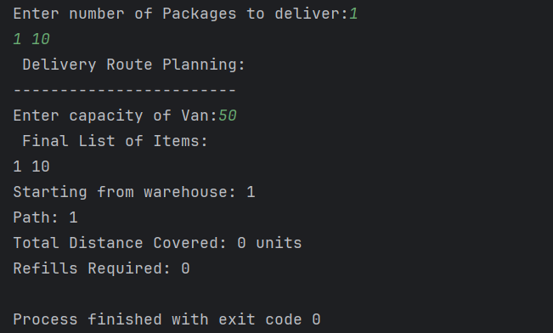
Case 4: No refills required
Case 5: Source= Final Point

Slide 37
Future Enhancements
Dynamic traffic conditions
Time window constraints
Multiple vehicle support
Real-time route adjustments
Machine learning for demand prediction
Environmental impact optimization

Slide 38
Work Distribution
Anvesha
Contributed ideas, helped redefine the problem scope and collaborated initial design.
Assisted with algorithm selection, tested code on sample data for validation.
Drafted technical report, created system architecture and interpreted the flow of code diagrammatically on flowcharts.
Debugged and improved code quality by redefining structure and global parameters for better modularity.
Pratyush
Started the ideation of the problem, identified key constraints and formulated the route optimization challenge.
Tried out relevant algorithms and implemented the main one’s in C++ 20, and optimized using different algorithmic techniques.
Prepared visual aids and worked on PowerPoint presentation.

Slide 39
References
GeeksforGeeks (2018). Dijsktra’s algorithm. [online] GeeksforGeeks. Available at: https://www.geeksforgeeks.org/dijkstras-shortest-path-algorithm-greedy-algo-7/
cp-algorithms.com. (n.d.). Floyd-Warshall Algorithm - Algorithms for Competitive Programming. [online] Available at: https://cp-algorithms.com/graph/all-pair-shortest-path-floyd-warshall.html.
GeeksForGeeks (2012). 0-1 Knapsack Problem | DP-10. [online] GeeksforGeeks. Available at: https://www.geeksforgeeks.org/0-1-knapsack-problem-dp-10/.
Wikipedia Contributors (2019). Greedy algorithm. [online] Wikipedia. Available at: https://en.wikipedia.org/wiki/Greedy_algorithm.
‌
‌

Slide 40
Thank You

